Slide 1


1
MIGRATION VALUE
ORACLE TO AZURE SQL
AI MIGRATION AGENT
01
AI-driven assessment
02
Dependency-aware discovery
Dashboard walkthrough, migration lifecycle and AI-assisted conversion framework
03
Controlled schema conversion
Assessment • Conversion • Migration • Validation
04
Validation and reporting
DXC Internal | July 2026
Prepared for stakeholder review
DXC Internal © 2026 DXC Technology Company. All rights reserved.
Notes:
[Sources]
- User-provided PowerPoint template, DXC branding style and Oracle to PostgreSQL AI migration dashboard screenshots.

Slide 2
2
Agenda
DISCUSSION FLOW
Concise walkthrough for stakeholders and implementation teams
1
Overview & Scope
2
Dashboard and Connection Setup
3
AI Model Provider Configuration
4
Discovery, Selection & Assessment Logic
5
Schema Conversion and Data Type Mapping
6
Migration, Validation, Reporting & Next Steps
DXC Internal © 2026 DXC Technology Company. All rights reserved.
Notes:
[Sources]
- User-provided PowerPoint agenda content and DXC style reference.

Slide 3
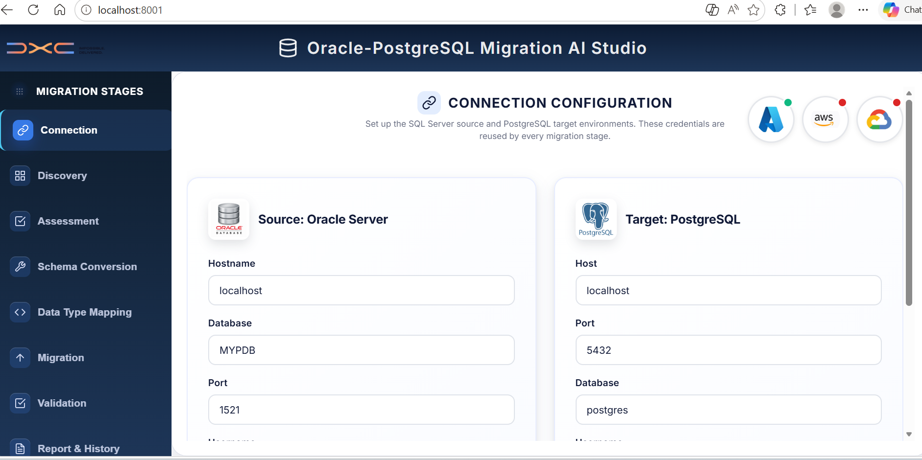
3
Overview
EXECUTIVE SUMMARY
AI-assisted modernization workflow from Oracle source to Azure SQL target
Business objective
Tool capability
Governance value
Accelerate Oracle to Azure SQL migration through guided discovery, AI assessment, conversion support, migration execution and validation.
Supports connection setup, dependency-aware object selection, AI configuration, schema conversion, mapping reports and history views.
Provides audit-friendly logs, status reports, validation output and AI token usage visibility for project governance.
End-to-end workflow: source discovery, AI readiness insights, controlled conversion and report-backed migration sign-off.
DXC Internal © 2026 DXC Technology Company. All rights reserved.
Notes:
[Sources]
- User-provided dashboard screenshots and migration workflow context.

Slide 4
4
Solution View
TOOL ARCHITECTURE AND AI INTEGRATION
Azure OpenAI-powered layer connected to the migration orchestration workflow
Oracle Source
Migration AI Studio
AI Model Providers
Azure SQL Target
Database metadata, schema objects, dependencies, PL/SQL and data type inventory
Configuration, discovery, assessment, conversion, migration, validation and reports
Azure OpenAI (GPT-4o deployment) accessed via secure enterprise endpoint with API key or Azure AD auth
Converted schema, mapped data types and validated migrated data
The AI model layer is configurable, so the same migration workflow can use the approved provider available for each project.
Connection → Discovery → AI Assessment → Conversion → Mapping → Migration → Validation → Reports
DXC Internal © 2026 DXC Technology Company. All rights reserved.
Notes:
[Sources]
- User-provided AI provider and migration workflow screenshots.

Slide 5
5
Workflow
MIGRATION LIFECYCLE
Clear explanation of each migration phase from discovery to reporting
Lifecycle slide is simplified without screenshots, so the audience can quickly understand the migration journey.
Connect
Discover
Assess
1
2
3
Configure Oracle source and Azure SQL target details. Validate credentials, host, port and database access.
Scan Oracle schema metadata and compare against the Delta Plan (new, changed, unchanged, blocked) before selecting objects.
Run AI-assisted compatibility, complexity, dependency and datatype assessment before conversion.
Convert
Migrate
Validate & Report
4
5
6
Generate Azure SQL-ready DDL/code and review conversion rules, mappings and exceptions.
Execute schema (idempotent DDL) and data migration using Append, Truncate and Reload, Incremental (SCN watermark) or Upsert modes, with per-table parallelism.
Validate row counts and checksums, generate reconciliation reports, AI executive summary and prepare handover evidence.
Control points: connection validation → assessment review → mapping approval → migration execution → validation sign-off → final report handover.
DXC Internal © 2026 DXC Technology Company. All rights reserved.
Notes:
[Sources]
- Migration lifecycle content derived from the user-provided dashboard workflow and Oracle to PostgreSQL AI migration tool context.

Slide 6
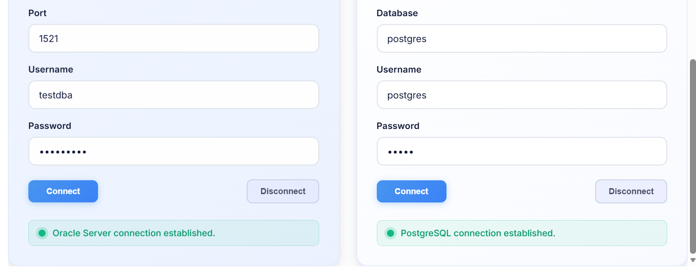
6
Dashboard
CONNECTION CONFIGURATION
Oracle source and Azure SQL target connection validation
Validate source and target connectivity before discovery, conversion and migration execution.
DXC Internal © 2026 DXC Technology Company. All rights reserved.
Notes:
[Sources]
- User-provided Oracle and PostgreSQL connection dashboard screenshots.

Slide 7
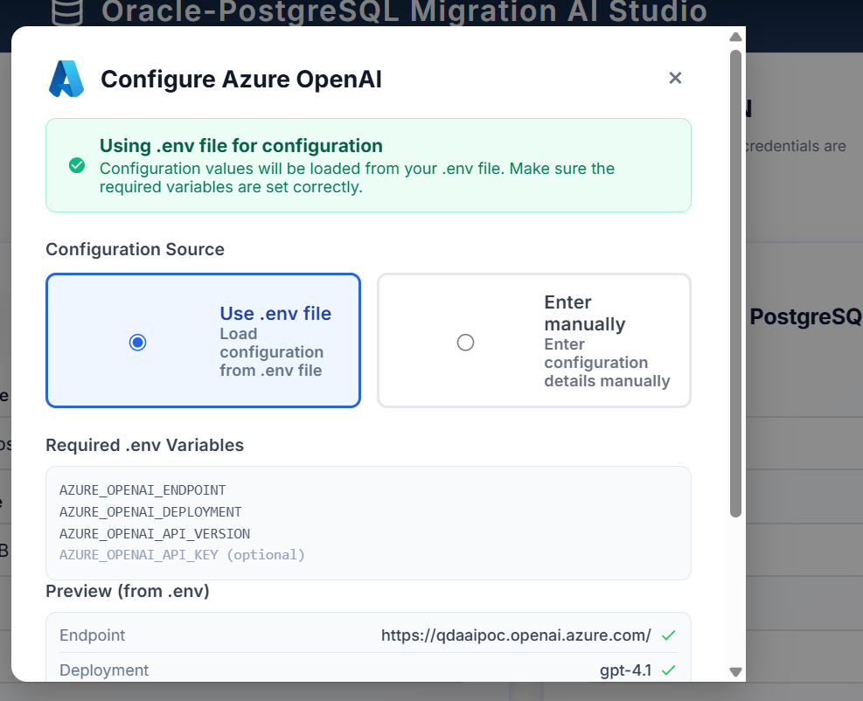
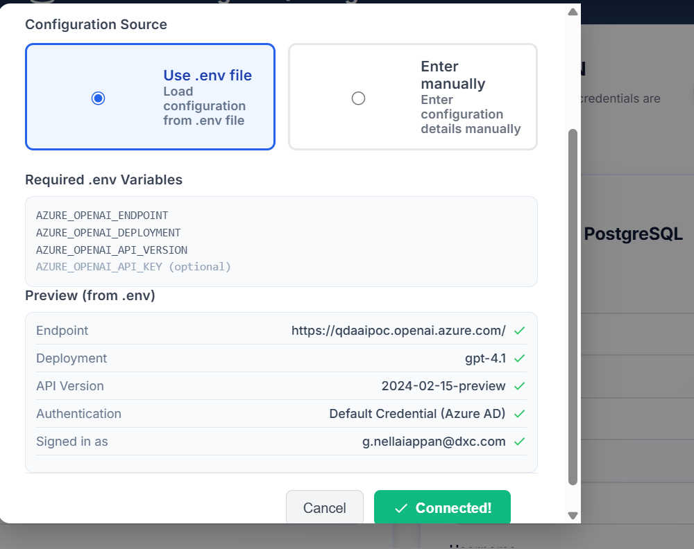
7
AI Layer
MODEL PROVIDER CONFIGURATION
Configuration can be loaded using .env or entered manually
Example shown: Azure OpenAI endpoint, deployment, API version, authentication and signed-in user verification.
DXC Internal © 2026 DXC Technology Company. All rights reserved.
Notes:
[Sources]
- User-provided Azure OpenAI configuration screenshots.

Slide 8
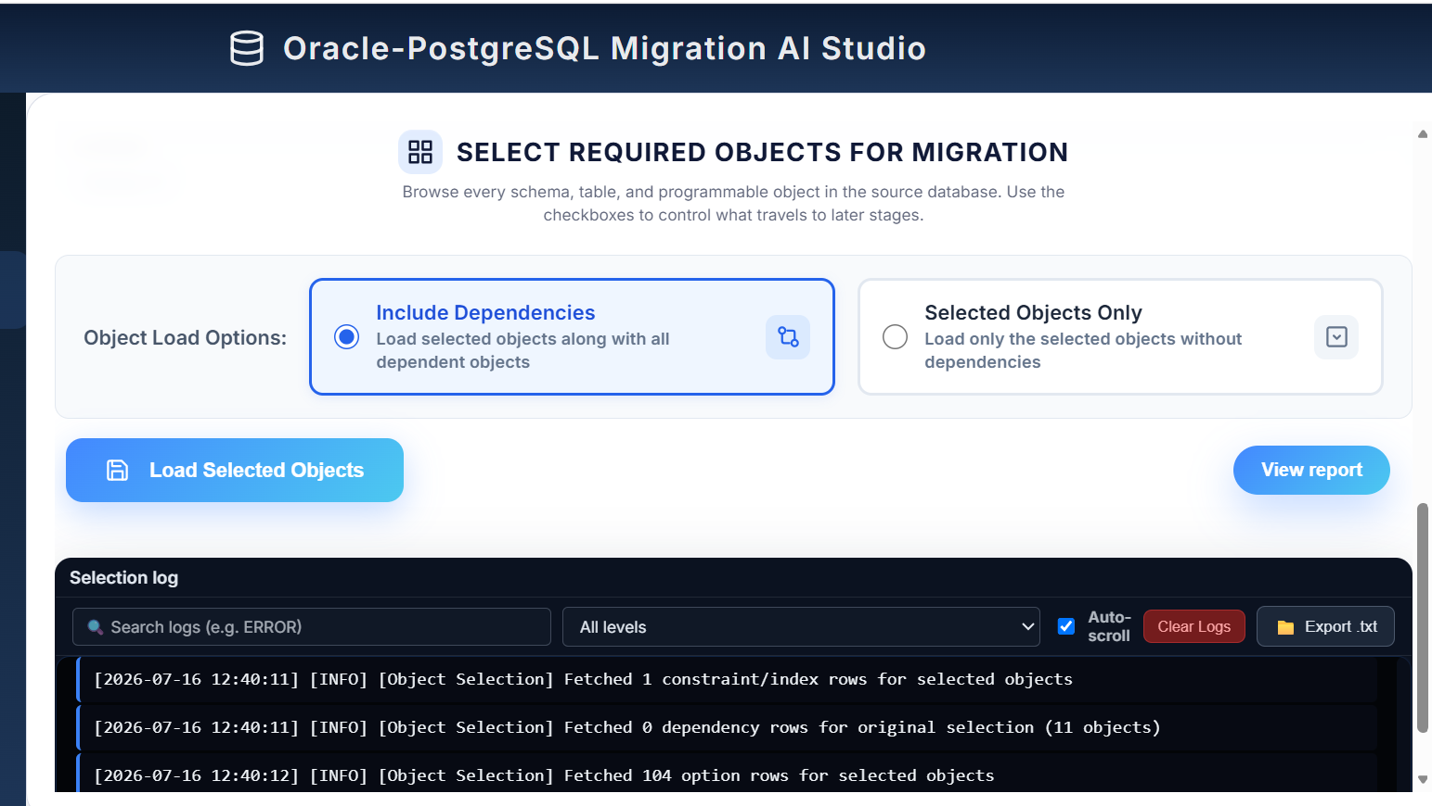
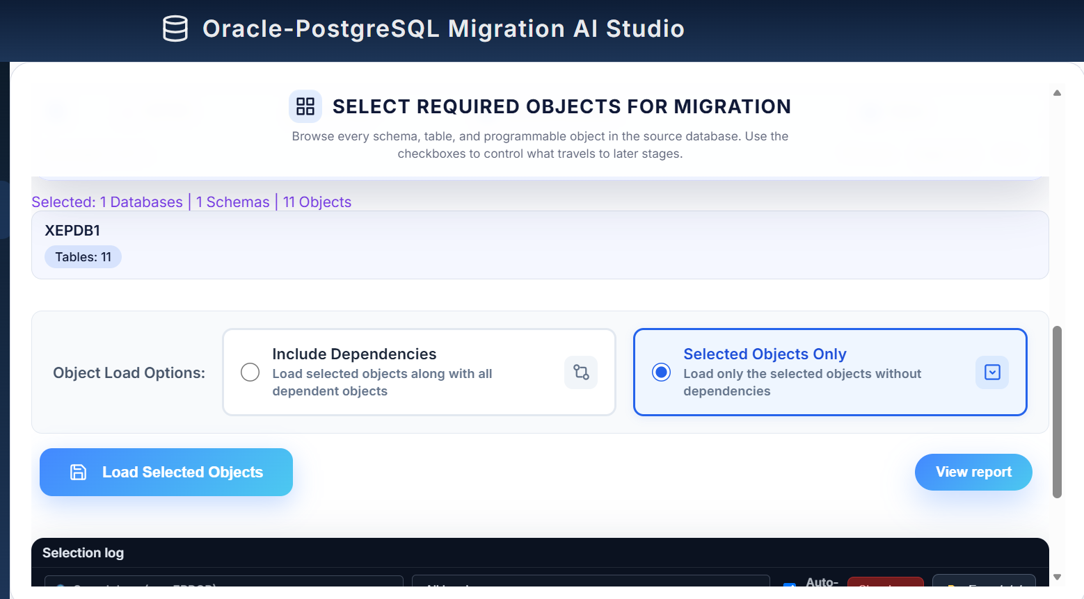
8
Discovery
OBJECT SELECTION AND DEPENDENCY HANDLING
Select required objects with or without dependency expansion
Recommended approach: review the Delta Plan (New / Changed / Unchanged / Blocked) to skip already-migrated, unchanged objects before assessment.
DXC Internal © 2026 DXC Technology Company. All rights reserved.
Notes:
[Sources]
- User-provided object selection and dependency handling screenshots.

Slide 9
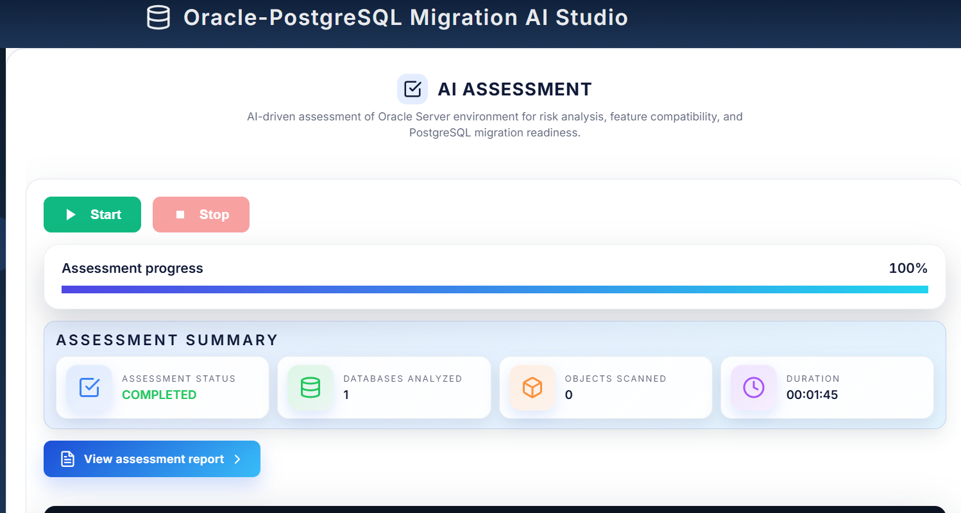
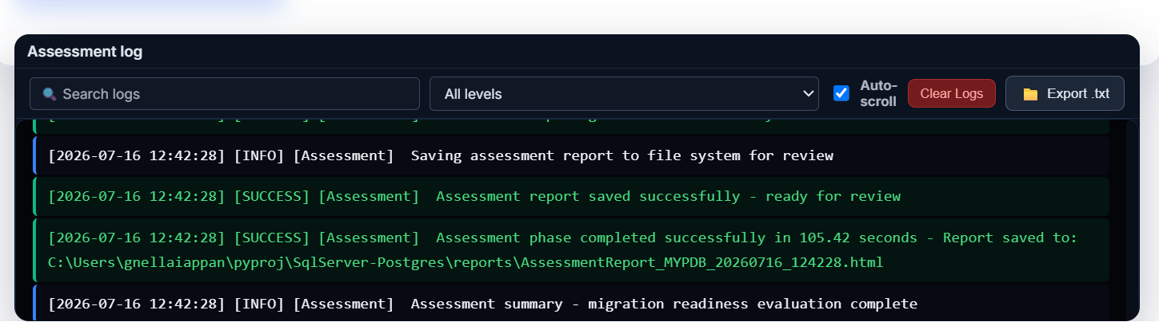
9
Assessment
AI ASSESSMENT LOGIC
How the tool converts metadata into migration readiness guidance
Extract
Classify
Score
Recommend
Read Oracle object metadata and dependency information
Identify compatible, partially compatible and Oracle-specific constructs
Calculate complexity using object types, dependency depth, datatype and PL/SQL usage
Generate remediation guidance and migration readiness summary
Assessment output gives the team a readiness view before conversion effort is committed.
DXC Internal © 2026 DXC Technology Company. All rights reserved.
Notes:
[Sources]
- User-provided AI assessment screenshots and dashboard log details.

Slide 10
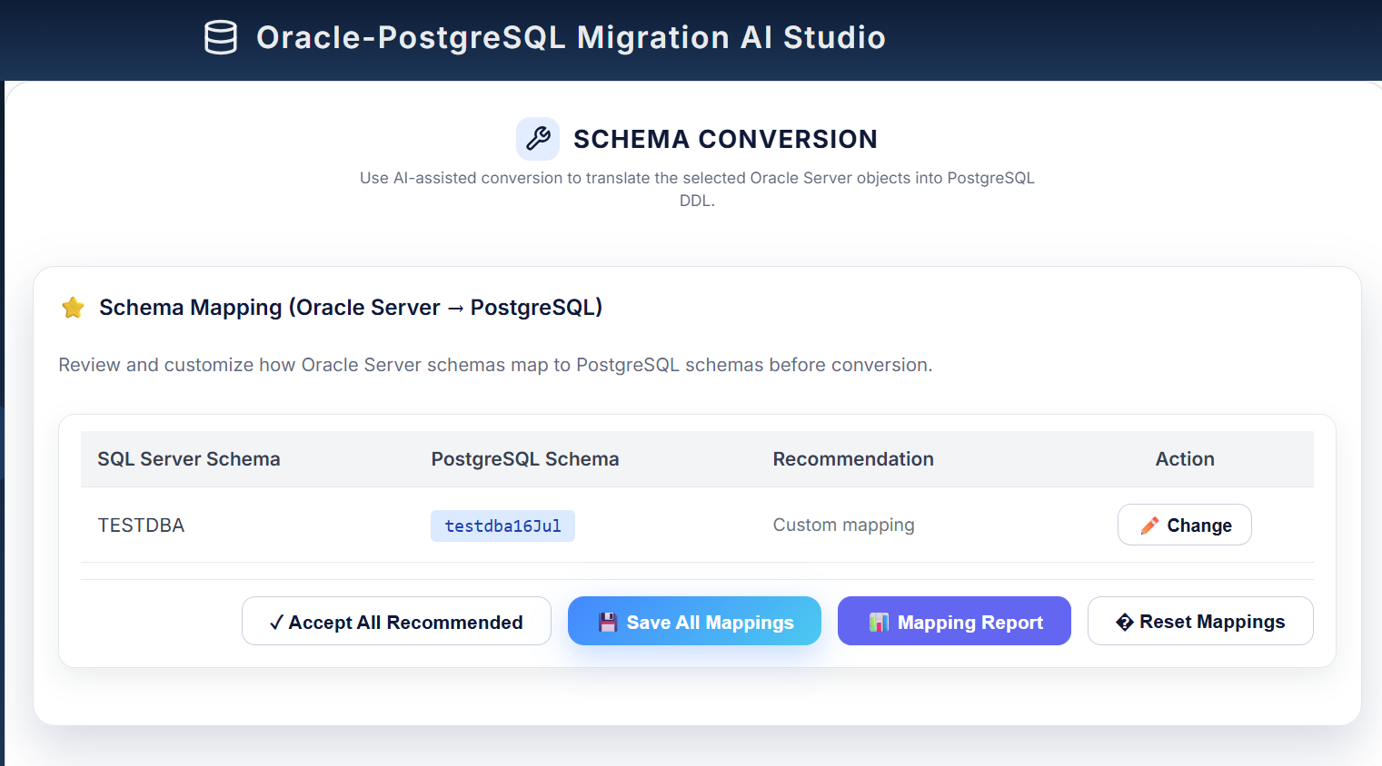
10
Conversion
SCHEMA CONVERSION
AI-assisted mapping from Oracle schema to Azure SQL schema
Controls
Accept all recommended mappings, save mappings, generate reports, change individual mappings and reset mappings.
Migration value
Makes schema mapping choices visible before DDL conversion and reduces unmanaged manual changes.
Governance
Mapping report provides evidence for DBA, application owner and migration stakeholder review.
DXC Internal © 2026 DXC Technology Company. All rights reserved.
Notes:
[Sources]
- User-provided schema conversion dashboard screenshot.

Slide 11
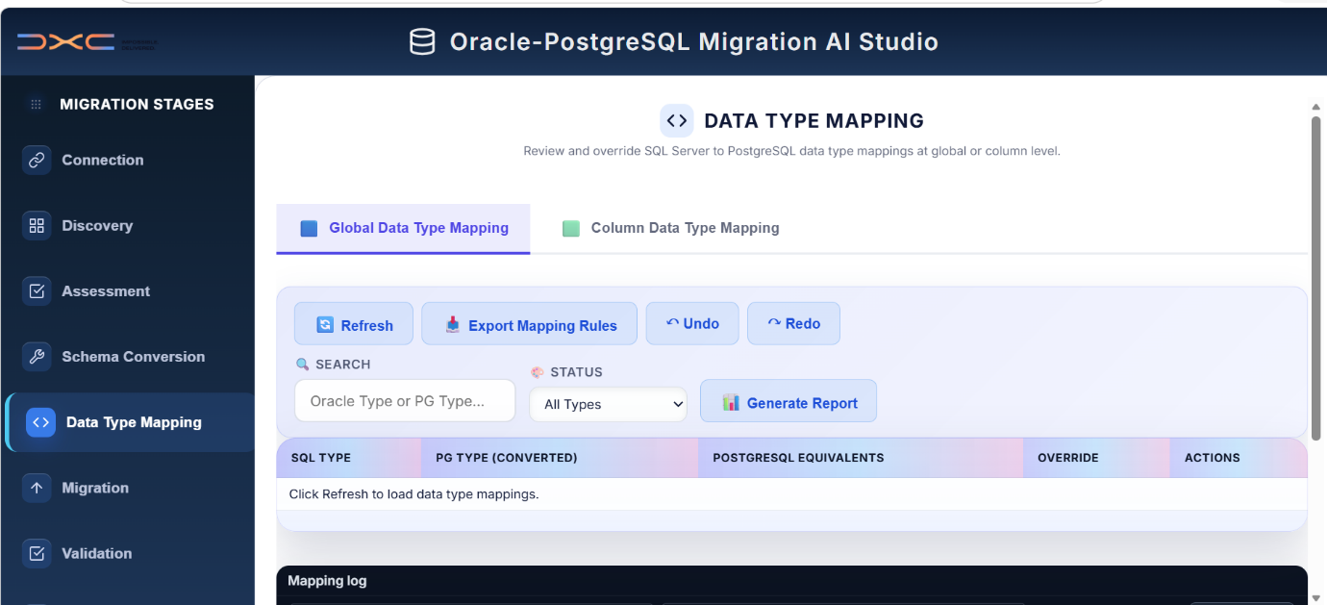
11
Mapping
DATA TYPE MAPPING
Review global and column-level Oracle-to-Azure SQL data type mappings
Global rules
Standard Oracle datatypes can be reviewed and exported as controlled conversion rules.
Column overrides
Special cases can be adjusted at column level for precision, date and LOB handling.
Traceability
Refresh, export, undo/redo and report generation support review before data movement.
DXC Internal © 2026 DXC Technology Company. All rights reserved.
Notes:
[Sources]
- User-provided data type mapping dashboard screenshot.

Slide 12
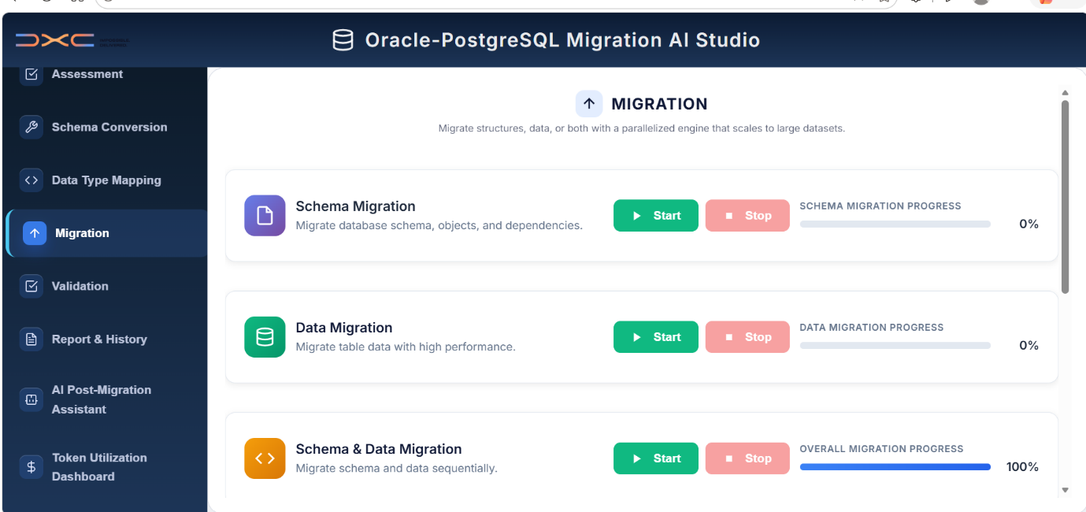
12
Execution
MIGRATION ACTIVITIES
Separate schema migration, data migration and combined migration execution
Schema migration
Idempotent DDL execution: CREATE TABLE statements skip objects that already exist on Azure SQL.
Data migration
Load modes: Append, Truncate and Reload, Incremental (ORA_ROWSCN watermark) and Upsert (stage + MERGE), with partitioned parallel table loads.
Schema & data
Combined run: up to 4 tables migrated concurrently, each tracked with row counts, duplicates skipped and failure samples.
DXC Internal © 2026 DXC Technology Company. All rights reserved.
Notes:
[Sources]
- User-provided migration execution dashboard screenshot.

Slide 13
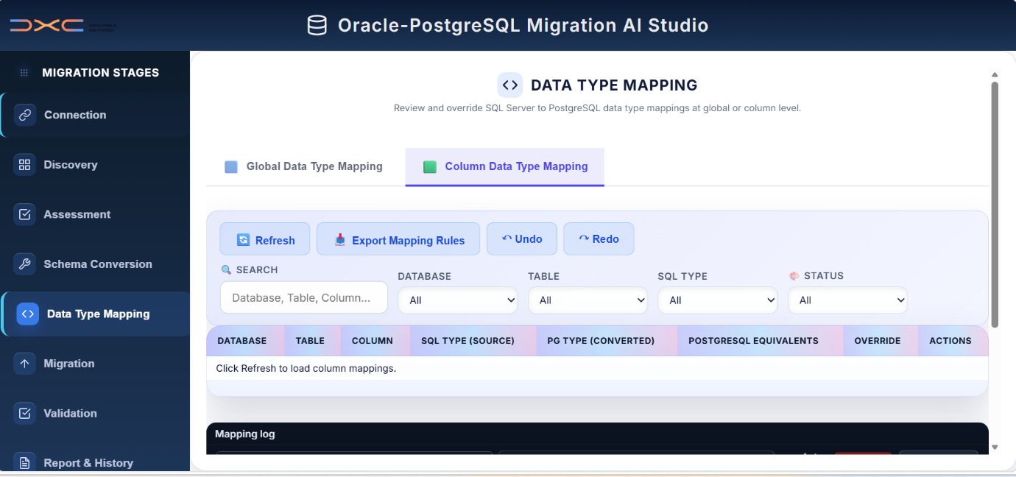
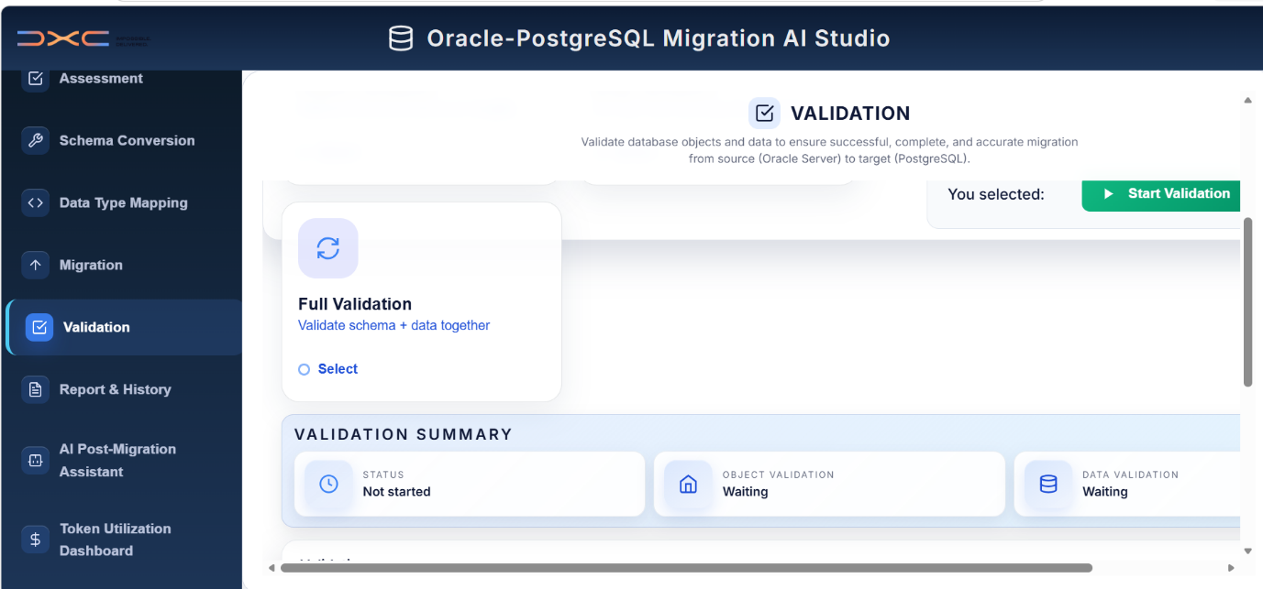
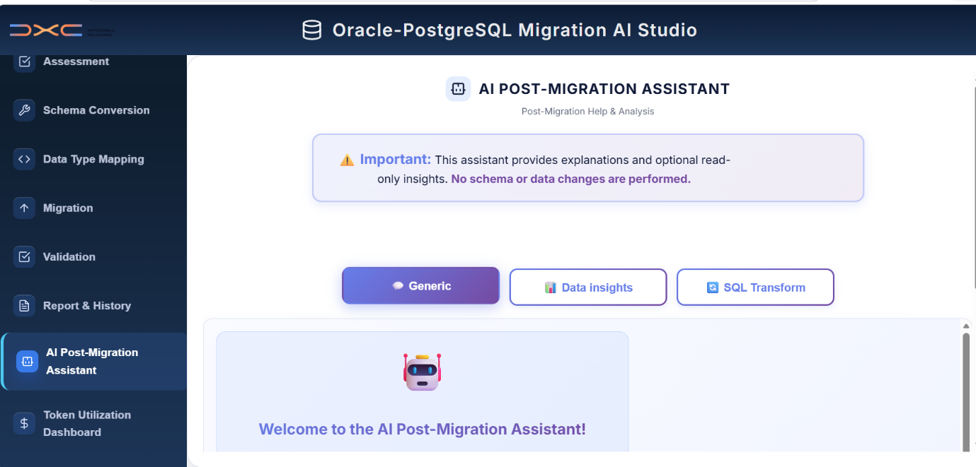
13
Governance
VALIDATION, REPORT & HISTORY
Migration quality checks and evidence generation
Validation
Reports & history
Assistant & tokens
Confirm object counts, status and post-migration quality gates.
Generate evidence packs and track migration execution history.
Support post-migration questions and monitor AI token utilization.
DXC Internal © 2026 DXC Technology Company. All rights reserved.
Notes:
[Sources]
- User-provided validation, report/history and assistant/token dashboard screenshots.

Slide 14
14
Benefits
BUSINESS VALUE DELIVERED
Operational confidence, faster assessment and improved governance
Accelerated migration assessment
Stage-based migration controls
Shorter discovery-to-readiness cycle
Clear checkpoints across the lifecycle
Reduced manual conversion analysis
Validation-focused quality gate
AI-assisted recommendations for technical teams
Post-migration checks before sign-off
Azure OpenAI-powered mapping
Post-migration assistant support
Consistent GPT-4o-driven schema and datatype recommendations
Guidance for follow-up questions
Traceable logs and reports
Token visibility for AI usage governance
Evidence for review and handover
Usage transparency for project controls
Overall impact: faster planning, better technical visibility and stronger migration governance.
DXC Internal © 2026 DXC Technology Company. All rights reserved.
Notes:
[Sources]
- Based on user-provided dashboard capabilities and migration workflow content.

Slide 15
15
Next Steps
RECOMMENDED PLAN
Suggested path to finalize the Oracle to Azure SQL AI migration tool package
1. Confirm Azure OpenAI configuration
Finalize Azure OpenAI endpoint, GPT-4o deployment and enterprise authentication for all environments.
Output: Azure OpenAI configuration checklist
2. Pilot representative schema
Test tables, constraints, indexes, views, packages, procedures and functions.
Output: pilot assessment results
3. Review assessment output
Validate AI classification, complexity score and remediation guidance.
Output: reviewed readiness report
4. Run controlled migration
Execute phased schema and data migration with validation and defect remediation.
Output: migration status and defects log
5. Prepare handover pack
Share assessment, mapping, migration, validation and token utilization reports.
Output: final governance evidence pack
DXC Internal © 2026 DXC Technology Company. All rights reserved.
Notes:
[Sources]
- Recommended next steps derived from the user-provided migration lifecycle and dashboard screens.

Slide 16
16
DXC Internal © 2026 DXC Technology Company. All rights reserved.
Notes:
[Sources]
- User-provided DXC style reference and presentation content.

